Slide 1
Object Oriented Systems Analysis
Event Analysis

Slide 2
Learning Objectives
State and discuss the goals of systems analysis.
Characterize a statement of system requirements as well as the process of systems analysis.
Define the term event and understand the implications of this definition.

Slide 3
Learning Objectives (continued)
Explain the difference between a temporal event and an external event.
Give appropriate names to events and recognize whether or not an event is named appropriately.
Carry out a business event analysis for a system and present the results in an event table.

Slide 4
Overview
The principal goal of information systems analysis is to state accurately users’ requirements for a new information processing system.
A six-step process for object-oriented analysis is introduced . Together, these six steps produce an event model, a use case model, system sequence diagrams, a model of the problem domain, and system operation contracts.

Slide 5
Overview (continued)
The initial step is business event analysis, which results in an event model, presented as an event table.
Event analysis treats the system as a black box and views it from a stimulus-response perspective.

Slide 6
Overview (continued)
An event is an occurrence which takes place at a specific time and triggers a predetermined response from the system. Because events occur independently of each other, event analysis is a powerful technique for breaking up a large or complex system into small, manageable, cohesive, independent parts.

Slide 7
Overview (continued)
Event analysis identifies the events to which the system is expected to respond, names the inputs and outputs, and identifies the actors – those who interact with the system by providing inputs and receiving outputs.

Slide 8
Goals of Systems Analysis
Primary Goal:
To state accurately the users’ requirements for a new information processing system

Slide 9
Goals of Systems Analysis (continued)
Secondary Goals:
To understand the users’ requirements.
To communicate the current understanding of the proposed system
To prevent expensive mistakes
To state a design problem
To state the conditions for system acceptance

Slide 10
Characteristics of a Statement of System Requirements
Graphic: Uses diagrams
Partitioned: Organizes the system description into comprehensible parts
Non-redundant: A change can be made in a single place
Accurate: Rigorous, precise, clear, consistent, and complete
Minimal: Eliminates non-essentials, while including all critical details

Slide 11
Procedure for Object-Oriented Systems Analysis
Step 1. Identify the business events and
make an event table.
Step 2. Identify the use cases and produce
a use case diagram for the system.
Step 3. Write a use case narrative
describing the system’s response
to each business event.

Slide 12
Procedure for Object-Oriented Systems Analysis (continued)
Step 4. Draw a system sequence diagram
for each use case scenario.
Step 5. Produce a domain model showing the concepts, attributes, and associations in the problem
domain of the system.
Step 6. Write a contract for each system operation.

Slide 13
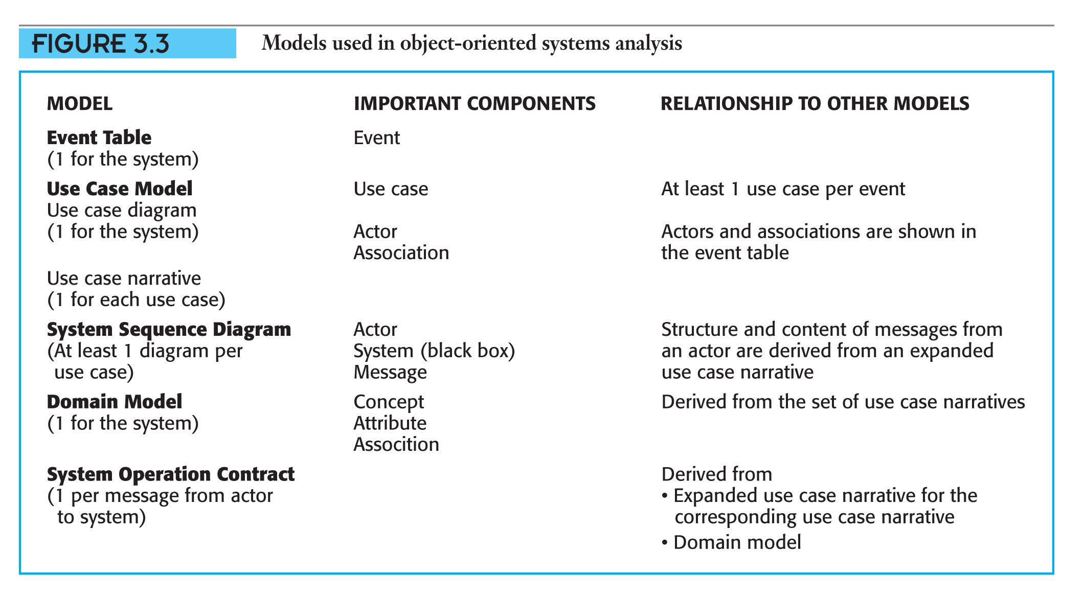
Models for Object-Oriented Systems Analysis
.
(Slides 3-15 — 3-20 Illustrate Typical Models)

Slide 14
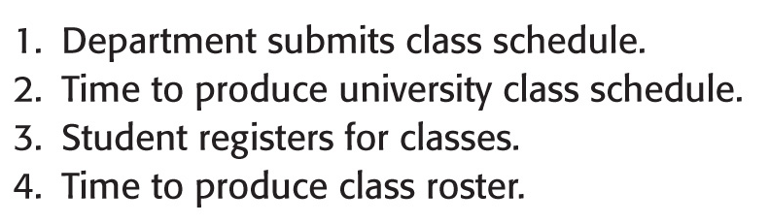
Typical Models – Event List
Event list for the university registration system

Slide 15
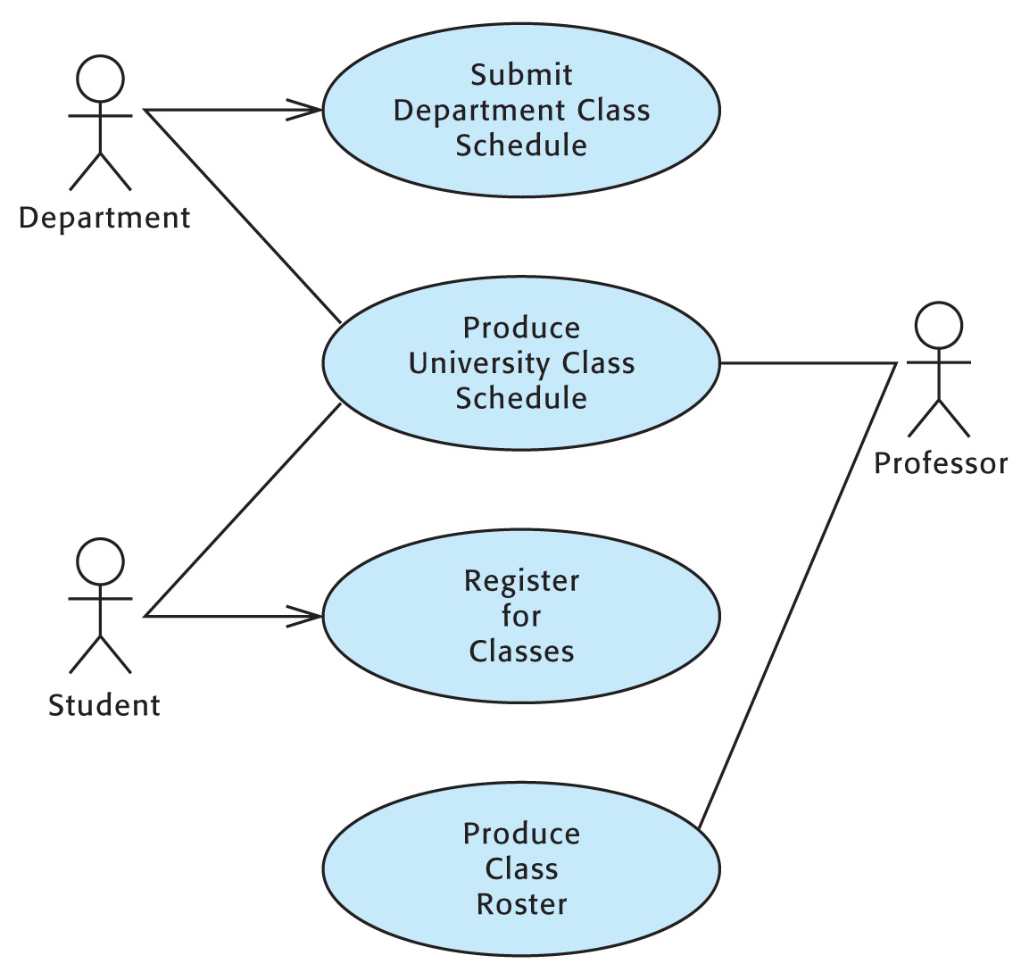
Typical Models – Use Case Diagram

Slide 16
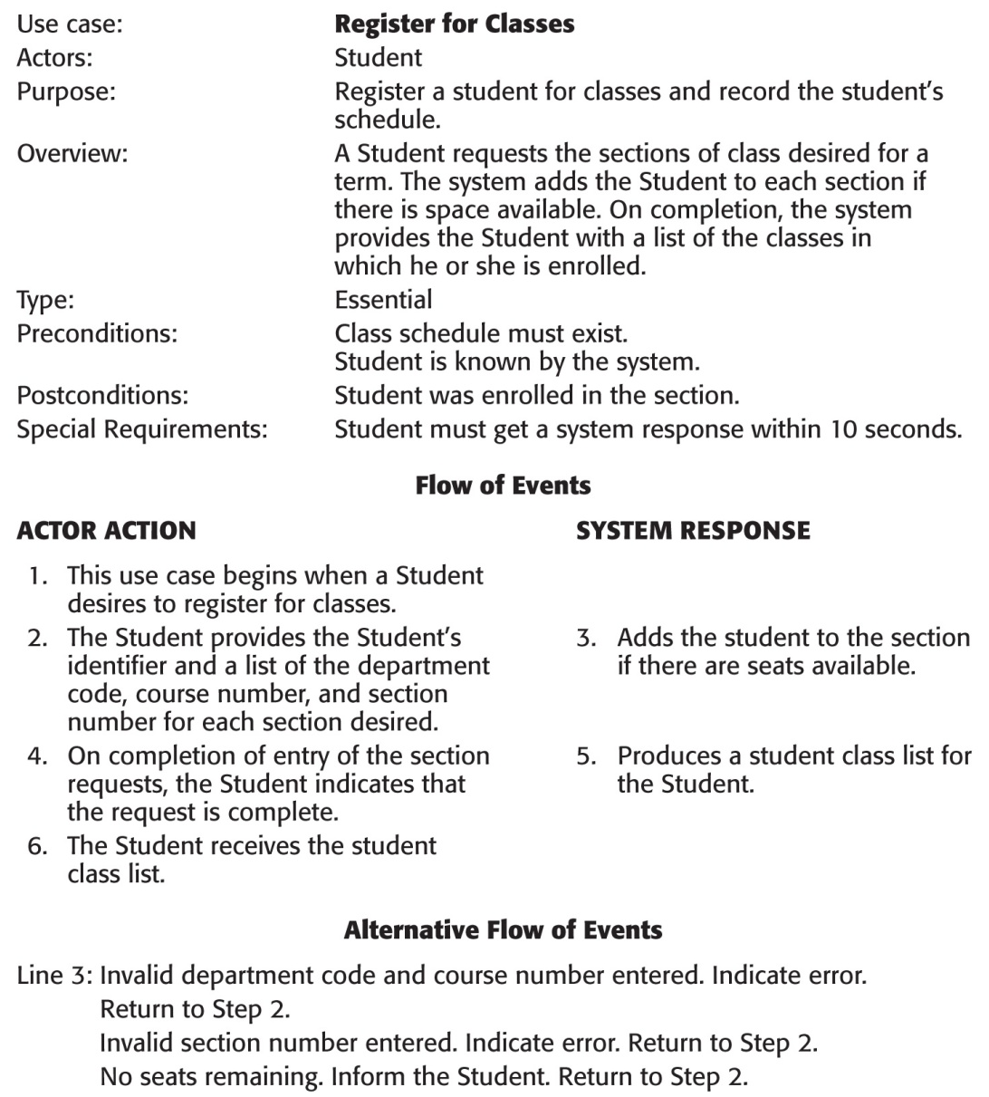
Typical Models – Use Case Narrative
.

Slide 17
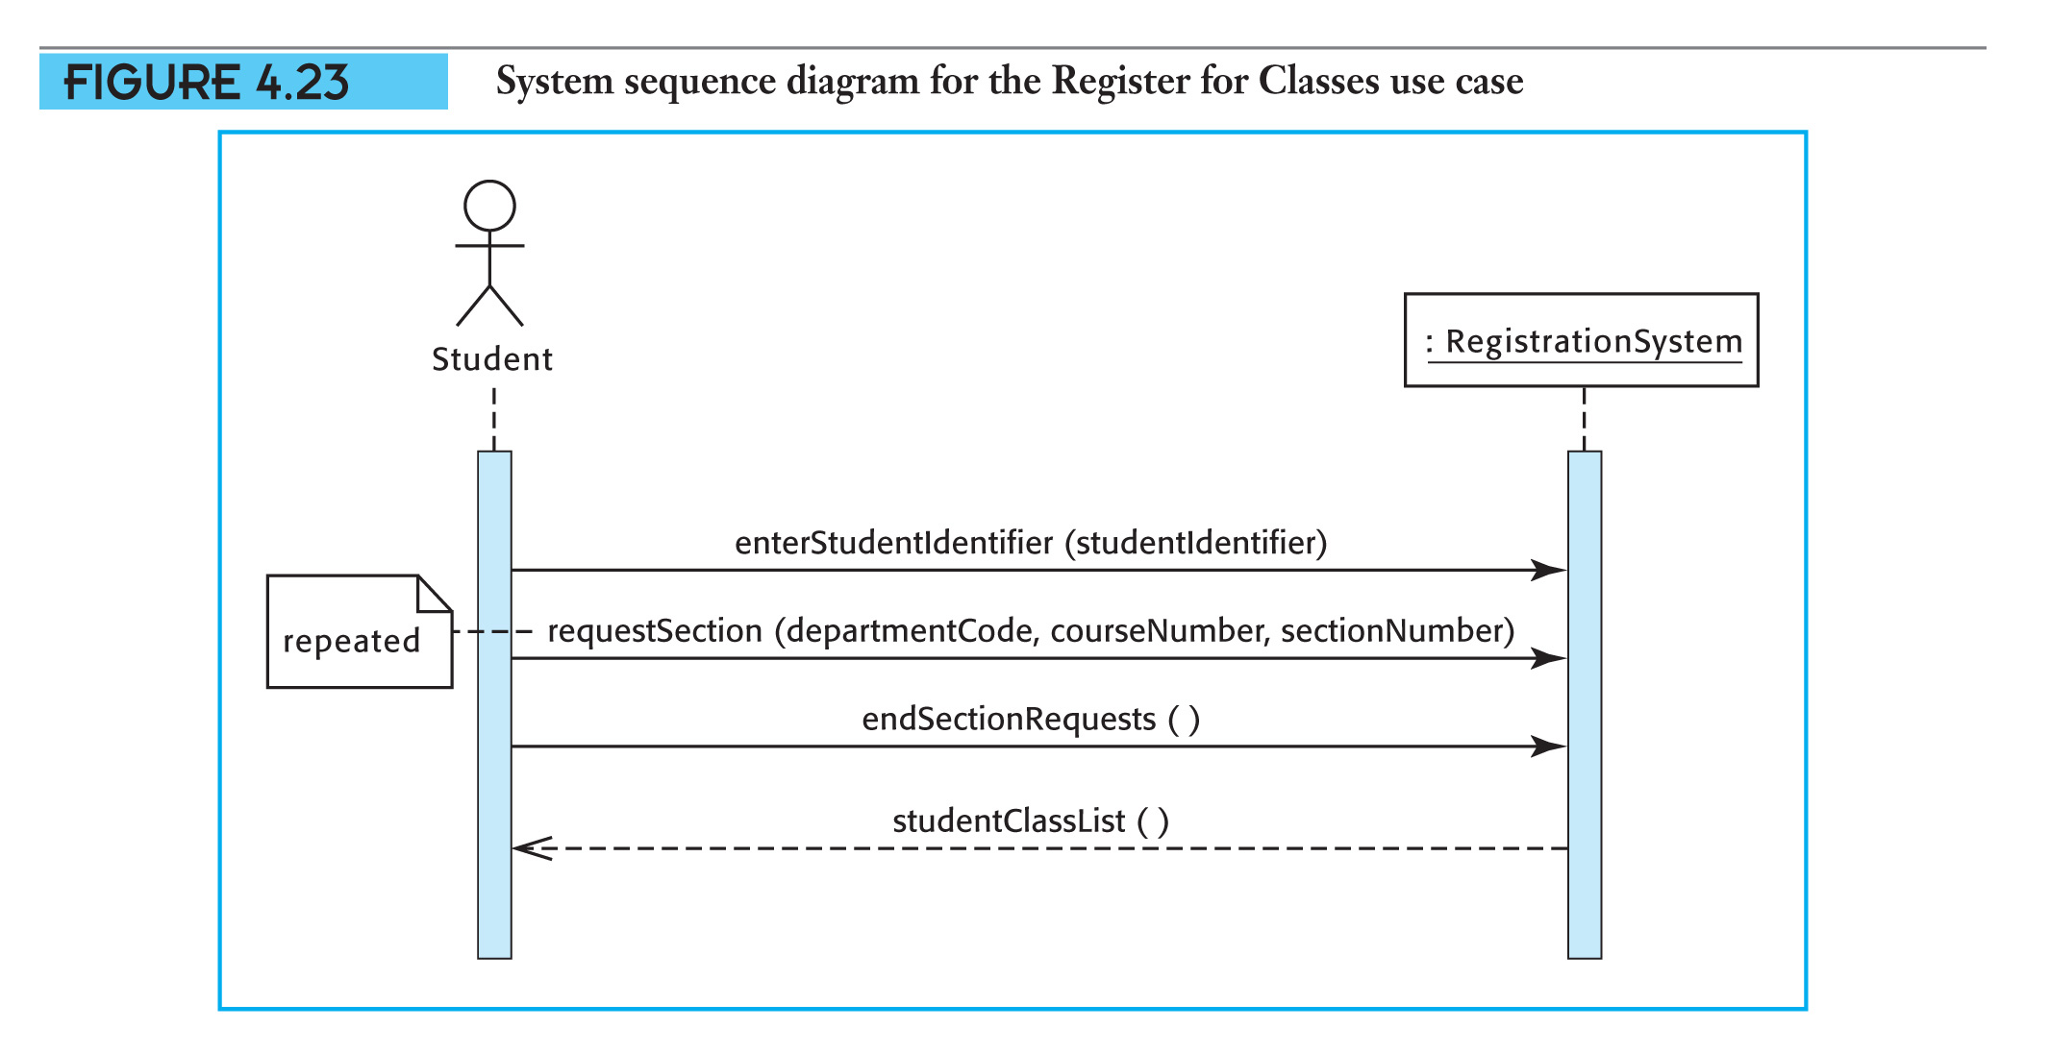
Typical Models – System Sequence Diagram

Slide 18
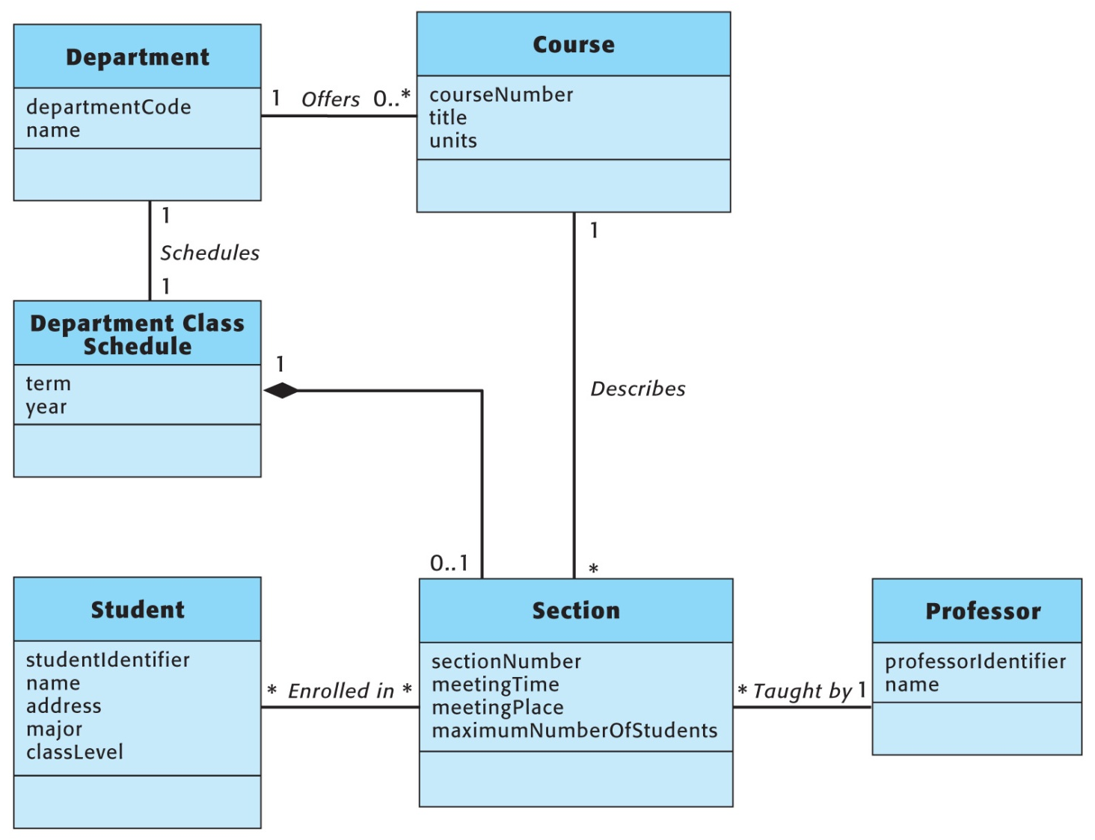
Typical Models – Domain Model

Slide 19
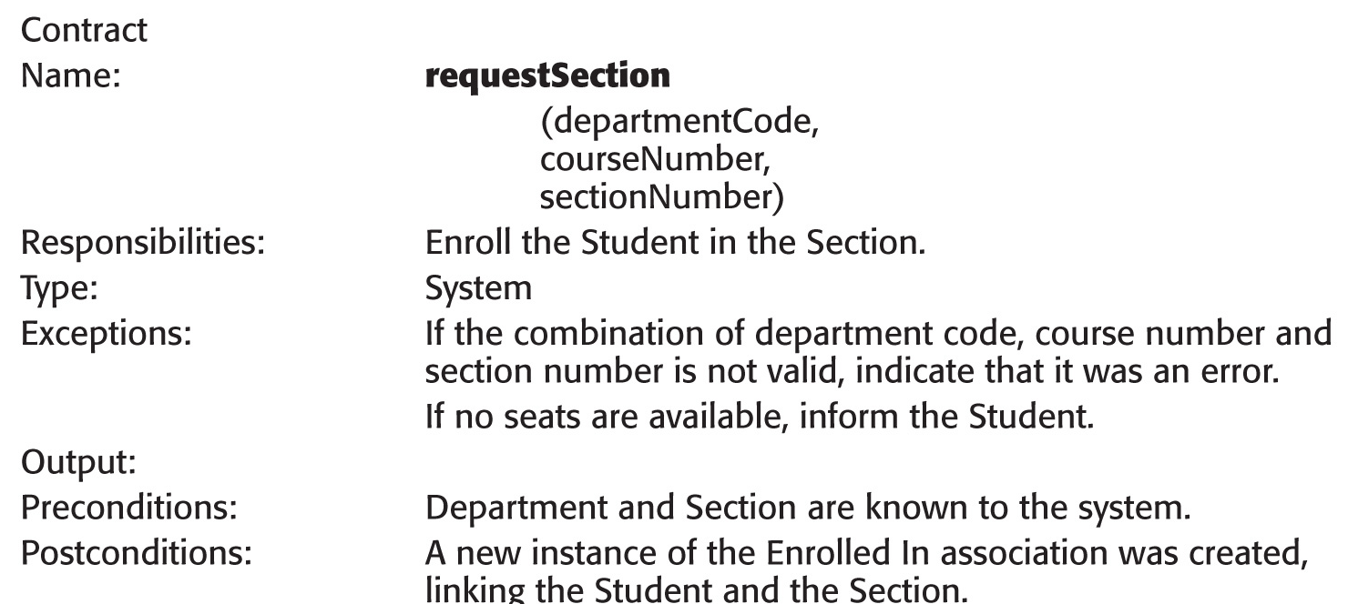
Typical Models – System Operation Contract

Slide 20
Techniques for Object-Oriented Analysis
Information –gathering Techniques
Event Analysis.
Use Case Modeling.
Domain modeling Techniques.
Walkthroughs

Slide 21
Event-Driven Systems
Event analysis takes a stimulus-response perspective –
The system does nothing until it is triggered by an event.
When an event occurs, the system responds as completely as possible.
After the response is complete, the system waits until another event occurs.

Slide 22
Events
An event is an occurrence which takes place at a specific time and initiates or triggers a predetermined response from the system.
An external event is an event which occurs outside the system boundary.
An internal event is an event which occurs inside the system boundary.
A temporal event is an event which occurs at a prespecified time.

Slide 23
Event Analysis
Event analysis creates a system description by identifying:
The events to which the system is expected to respond
The incoming message (event flow or
data flow) associated with each event
The desired response
The actions or behaviors required to generate the response for each stimulus

Slide 24
Event Analysis
Event analysis creates a system description by identifying :
The events to which the system is expected to respond.
The incoming message (event flow or data flow) associated with each event,
The desired response , and
The actions or behaviours required to generate the response for each stimulus.

Slide 25
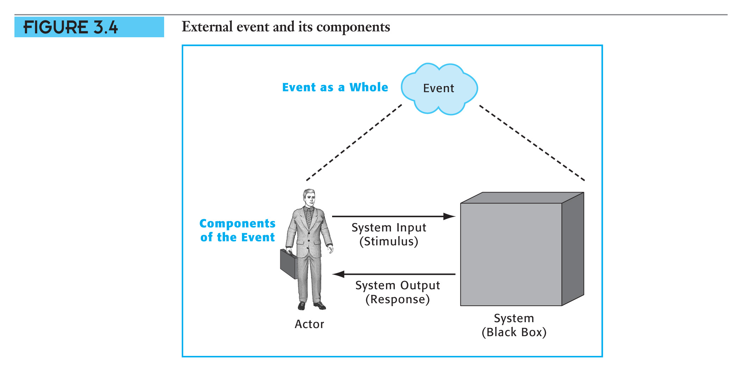
Event Analysis (continued)
(Insert Figure 3.4)

Slide 26
Event Flows and Data Flows
An event flow is an information flow which contains no application-specific data. An incoming event flow merely notifies the system that a particular event has occurred and triggers the system to respond.
Data Flows contains application-specific data elelements with specific values which decsribe details of the event. Example
A withdrawal request might consist of
Account Number
Withdrawal Date , and
Withdrawal Amount
An incoming data flow serves two purposes:
Its arrival triggers the system to respond .
The flow contains the data essential for the system to produce the required response .

Slide 27
Identify the Business Events
Event List for the Public University Registration System
External 1. Department submits class schedule
Temporal 2. Time to produce university class schedule
External 3. Student registers for classes
Temporal 4. Time to produce class roster

Slide 28
Identify the Actors, Inputs, and Outputs
Who supplies system inputs?
Department submits a Department Class
Schedule.
Student supplies a list of desired classes (a Registration Request).

Slide 29
Identify the Actors, Inputs, and Outputs (continued)
Who receives system outputs?
Departments, Professors, and
Students receive the University
Class Schedule.
Student receives a Class List.
Professors receive Class Rosters.

Slide 30
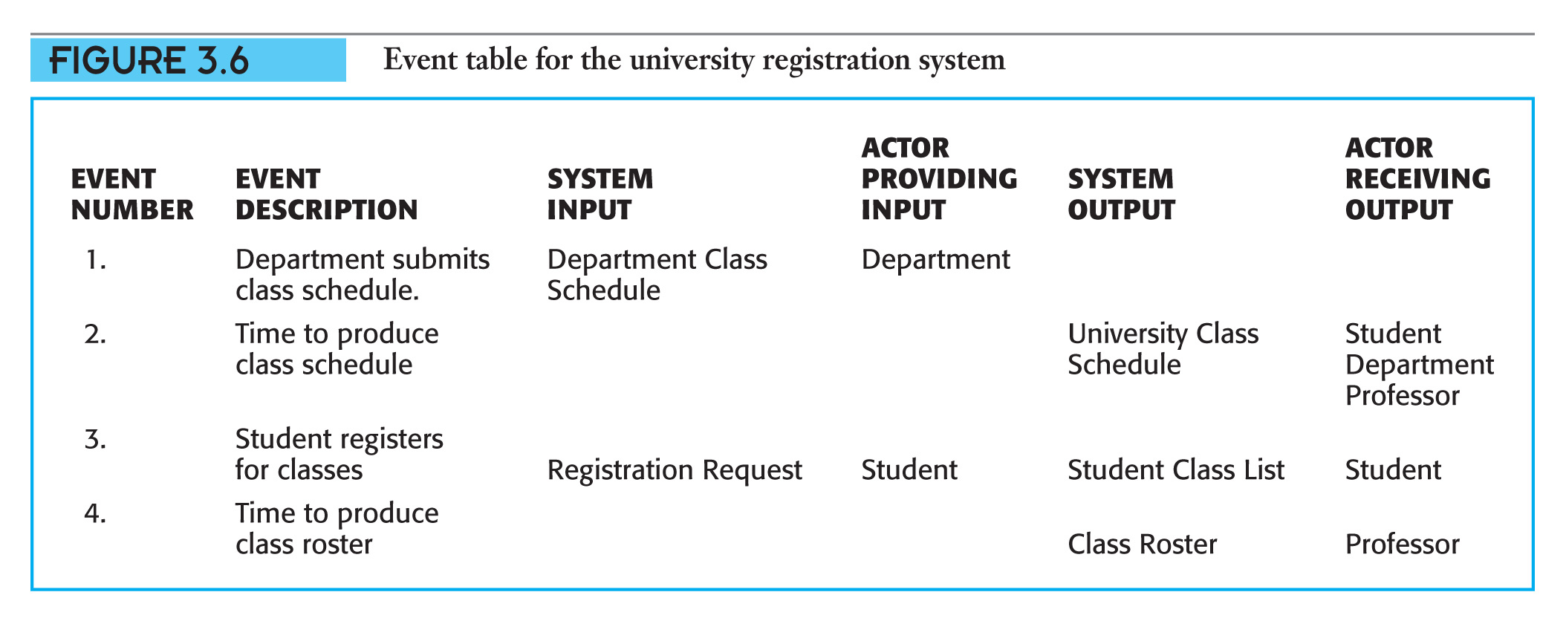
Event Table
.

Slide 31
Hints About Event Analysis
Ignore the technology of implementation – build an essential event model.
Model the system’s complete
response – don’t split a single event into fragments.
Isolate individual events – don’t combine events if the system must wait in between them.

Slide 32
Summary
The goal of systems analysis is to state users’ requirements for a new information system correctly.
The initial step in object-oriented systems analysis is event analysis.
Event analysis identifies external and temporal events and the system’s expected responses.

